Slide 1
Tic Tac Toe with Minimax and Alpha-Beta Pruning
Course - Artificial Intelligence Lab
Team Member-
Ripa Rani Biswas(20201001)
Md. Mominul Huque(20201049)
Anowar Hossen Farvez(20201059)

Slide 2


Table Of Contents
1
2
Problem Statement
Introduction
3
4
Sample Input Output
Conclusion
5
Technical Report & Code

Slide 3
Problem Statement
The objective of this assignment is to implement the classic game of Tic Tac Toe as an adversarial search problem and develop an AI player using the minimax algorithm with alpha-beta pruning.

Slide 4
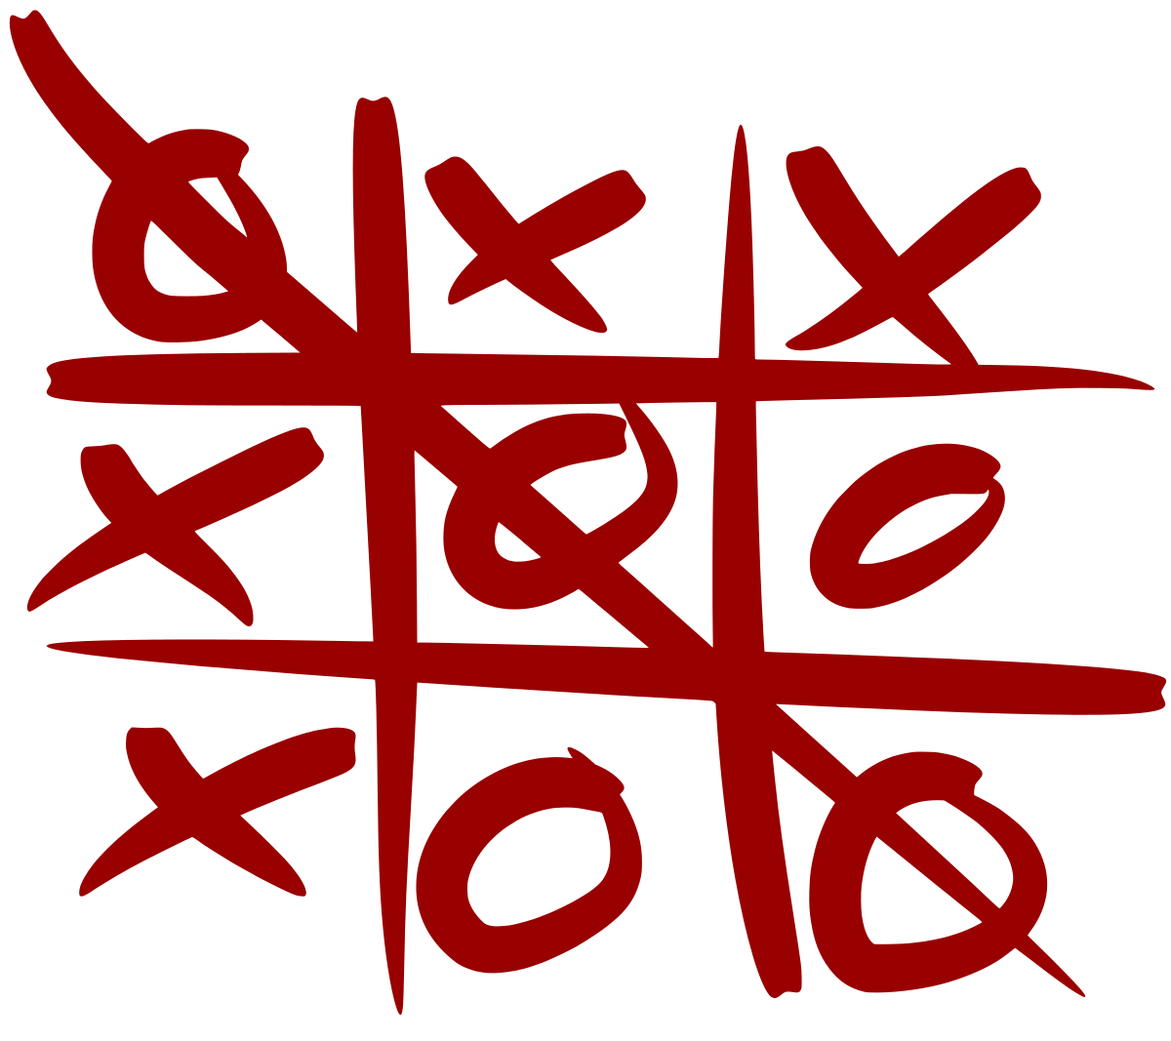
Introduction
Tic Tac Toe is a paper-and-pencil game for two players who take turns marking the spaces in a three-by-three grid with X or O.
In this project, we’ll treat it as an adversarial search problem and develop an AI player using the minimax algorithm with alpha-beta pruning.

Slide 5
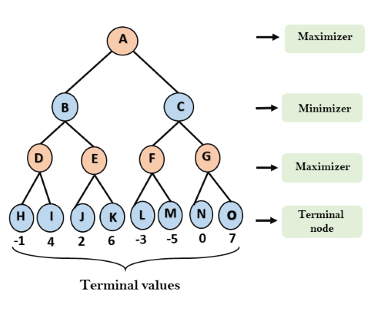
Minimax Algorithm
It is a kind of backtracking algorithm that is used in decision making and game theory to find the optimal move for a player, assuming that your opponent also plays optimally. It is widely used in two player turn-based games such as Tic-Tac-Toe, Backgammon, Mancala, Chess, etc.

Slide 6
Alpha-Beta pruning
It is not actually a new algorithm, but rather an optimization technique for the minimax algorithm.
It cuts off branches in the game tree which need not be searched
This allows us to search much faster and even go into deeper levels in the game tree
Thus it reduces the computation time by a huge factor.

Slide 7
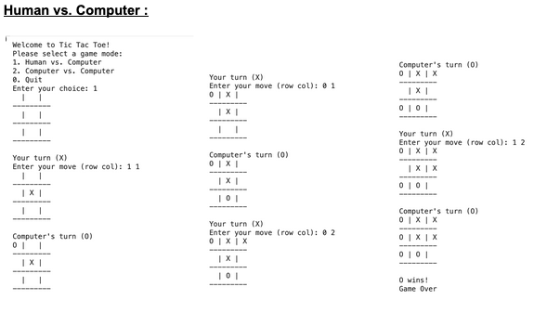
Sample Input Output

Slide 8
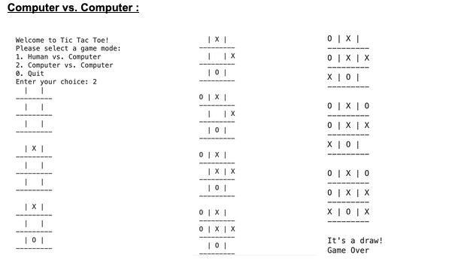
Sample Input Output

Slide 9
Conclusion
Creating a Tic Tac Toe game using Minimax and Alpha-Beta Pruning techniques is a helpful exercise in AI and game development. It teaches us about adversarial search, decision-making, and optimization. Alpha-Beta Pruning makes the AI efficient and competitive in a simple game like Tic Tac Toe.

Slide 10
Technical Report Link
https://docs.google.com/document/d/13nyQ2JuYeFDtqb9bHRX0YLM6j2OBsg7S/edit?usp=sharing
Code link
https://colab.research.google.com/drive/1CzTtZOJWBlTYWGQLqezefkPAkrUHCuJL?usp=sharing

Slide 11
Thank You!

